Slide 1
An Introduction To C Programming
Aakanksha Chopra, Asst. Professor(IT)

Slide 2
Basic Concepts Background
What is a Computer?
It is a device capable of performing computations
and making logical decisions at higher speeds of
millions and billions times faster than what humans
can.
Aakanksha Chopra, Asst. Professor(IT)

Slide 3
Hardware
Does all physical work computers are known for.
Part of machine hence only understands 0/1-binary.
The computer hardware cannot think & make decisions on its own.
Aakanksha Chopra, Asst. Professor(IT)

Slide 4
Software
Commands hardware what to do & how to do.
Was developed to make efficient use of binary & to instruct the hardware to perform meaningful task.
Aakanksha Chopra, Asst. Professor(IT)

Slide 5
Hence hardware needs a software ( a set of programs) to instruct what has to be done.
Aakanksha Chopra, Asst. Professor(IT)

Slide 6
Program
Set of instructions that are arranged in a sequence to guide a computer to find a solution to a given problem.
Aakanksha Chopra, Asst. Professor(IT)

Slide 7
Programming
The process of writing a program is called Programming.
Aakanksha Chopra, Asst. Professor(IT)

Slide 8
Source Code
The programmer writes a set of instructions (program) using a specific programming language. Such instructions are called source code
Aakanksha Chopra, Asst. Professor(IT)

Slide 9
Compiler
Convertor
Converts source code to machine readable language or 0/1 in one go.
Converts High -level programming language to low-level programming language.
Object Code- Resultant code is converted from source code to binary is called OBJECT CODE
Aakanksha Chopra, Asst. Professor(IT)

Slide 10
Interpreter
Convertor
Converts source code to machine readable language or 0/1 line by line.
Converts High -level programming language to low-level programming language.
Intermediate Code- Resultant code is converted from source code to binary is called Intermediate CODE
Aakanksha Chopra, Asst. Professor(IT)

Slide 11
Linker
Link editor binder
It’s a program that combines object modules (object codes) to form an executable program.
Divides entire program in short modules
Then convert all short modules in object code
Finally linker links back all object codes in 1 single program
Compiler automatically invokes linker as last step in compiling a program
Aakanksha Chopra, Asst. Professor(IT)

Slide 12
LOADER
It is a special type of program that copies prog. From storage device to main memory, where they can be executed.
Task of loader is to bring the program & all its related files into the main memory from where it can be executed by the CPU.
The functionality of the loader is generally hidden from the programmer.
Aakanksha Chopra, Asst. Professor(IT)

Slide 13
Programming languages
Aakanksha Chopra, Asst. Professor(IT)

Slide 14
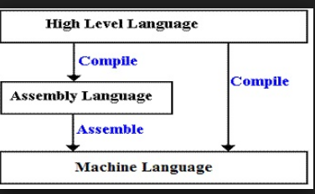
Have syntax and semantics
Have unique set of keywords & special syntax for organizing program instructions
Aakanksha Chopra, Asst. Professor(IT)

Slide 15
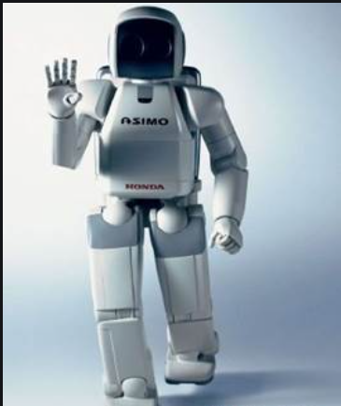
Generations of Programing
Based on characteristics of various computers developed from time to time, they are categorized as generation of computers.

Slide 16
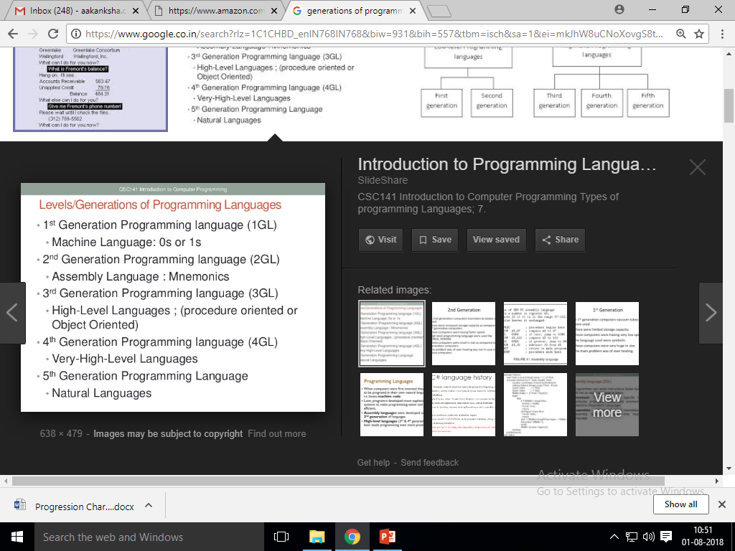

Slide 17
INTRODUCTION TO C PROGRAMMING

Slide 18
The programming lang. C was developed in 1972 at AT & T’s Bells laboratories of USA. It was developed by DENNIS RITCHIE to be used by the UNIX Operating System.
C is derived from other 3 languages-
ALGOL(1st language to use a block structure)- ALGOL was introduced in 1960’s & was a way of developing ‘STRUCTRURED POGRAMMING CONCEPT’

Slide 19
b. BCPL(Basic Combined Programming Language)- developed in 1967 by Martin Richards developed this language. BCPL was basically a type-less(had no concept of datatypes) language which facilitated the user with direct access to memory, which was useful for system programming.
c. B (Basic)- developed in 1970 by Ken Thompson. He developed this & it was for 1st version of UNIX.
C language was developed in 1972 which took concepts from ALGOL, BCPL, B

Slide 20
C is called Middle Level Language
It combines best features of HLL and control and flexibility features of ALL/LLL.
Combines features of ALL which help in writing business software packages.
Allows manipulation of bits, bytes & address-the basic elements with which computer functions.
C is portable. Platform independent.

Slide 21
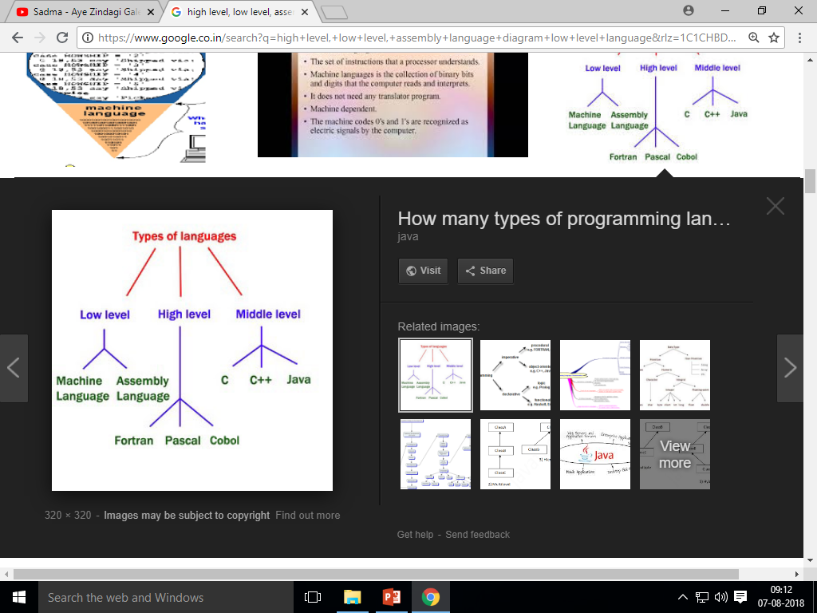

Slide 22
C is called Structured Language

Slide 23
Compartmentalization of Code & Data.
section off or hide from rest of the programs
Supports while, do-while, for loop
It develops only what the function does, not how it does.
local variables, subroutines/ functions
Block Structured language

Slide 24
‘C’ is so popular because it is reliable, simple, & easy to use, & also need on different platforms, therefore there are only few computer architecture on which a ‘C’ complier does not exists.

Slide 25
C’s Character Set
Single quotes- ‘ ’
A-Z, a-z, 0-9, special symbols.
Eg- ‘2’ , ‘B’, ‘j’, ‘@’, ‘&’

Slide 26
Identifiers
Identifies data & other objects.
Identifiers are names given to elements such as variables, arrays & functions.
Consists of alphabet, digit, or an underscore.

Slide 27
Rules for Identifier Name
Cannot include any special character or punctuation marks (like- #, $, ^, ?, .) except underscore ( _ )
__
Keywords-
Case sensitive
Must begin with an alphabet or _
Any length less than 32 characters

Slide 28
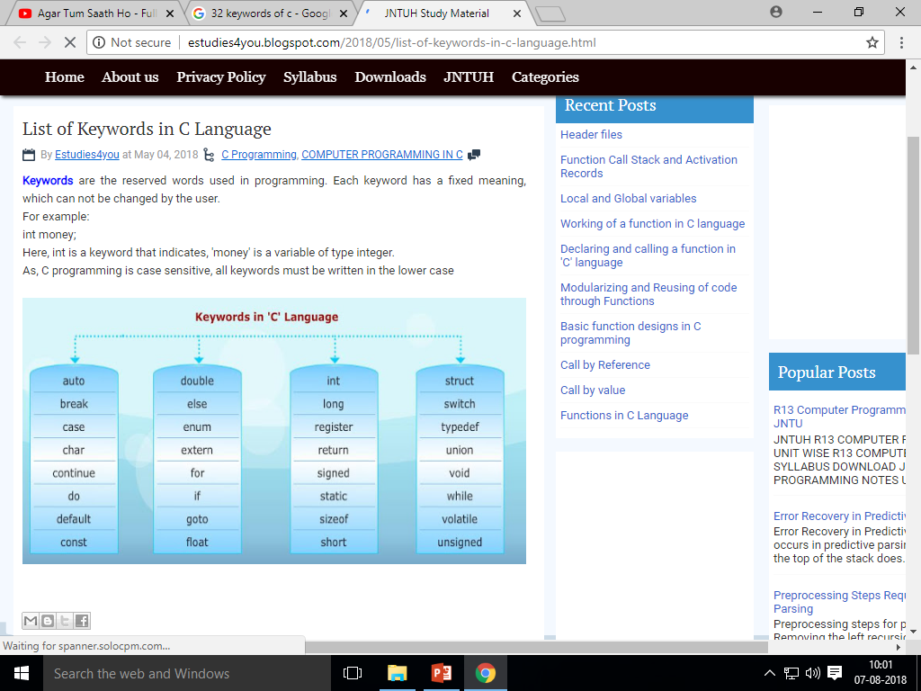
Keywords in C
32 reserved words.
Case sensitive in Nature.
Are Always in Lower Case.

Slide 29
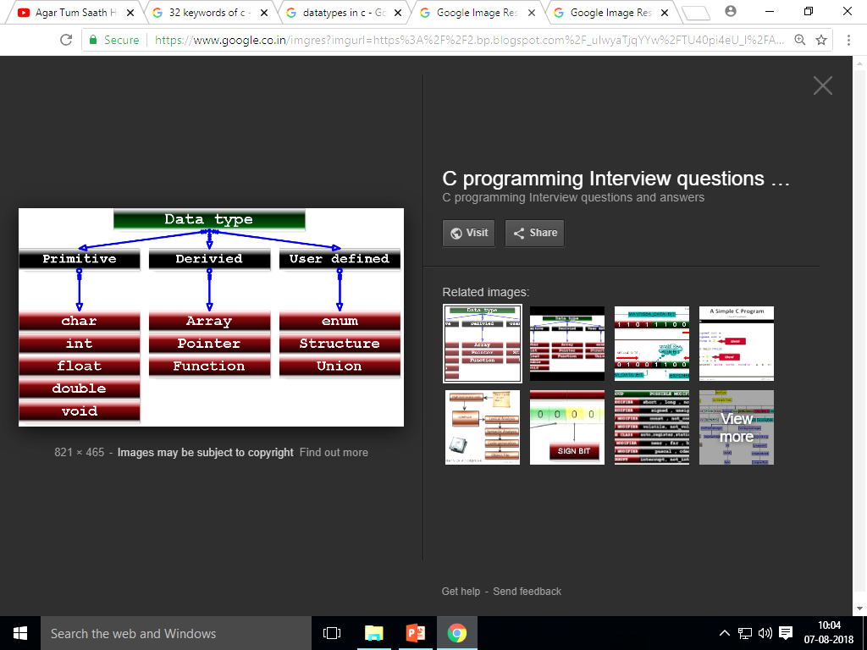
Datatypes in C

Slide 30
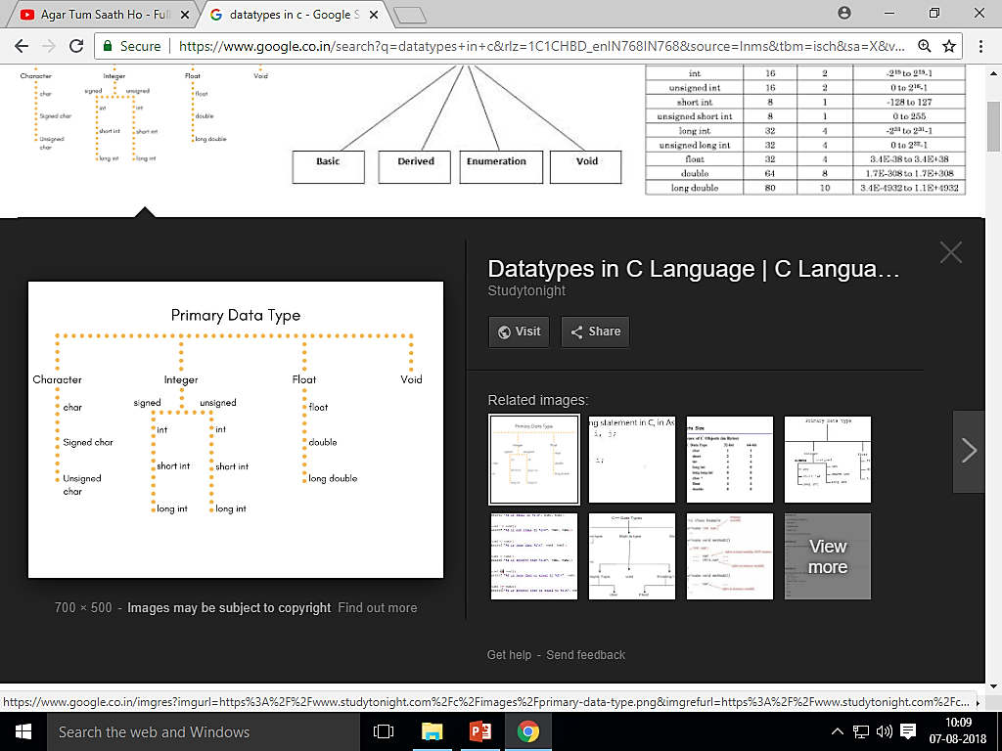
Cont…

Slide 31
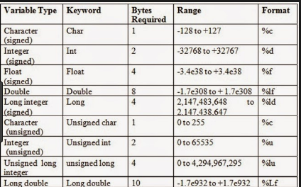
Cont….

Slide 32
Cont..
Character | ASCII Range
A-Z | 65-90
a-z | 97-122
0-9 | 48-57
It stores char ‘A’ as ASCII 65 in memory and not as char ‘A’

Slide 33
Variables
A variable is defined as a meaningful name given to the data storage location in computer memory.
When using a variable we actually refer to address of memory where the data is stored.
Numeric and character variables.

Slide 34
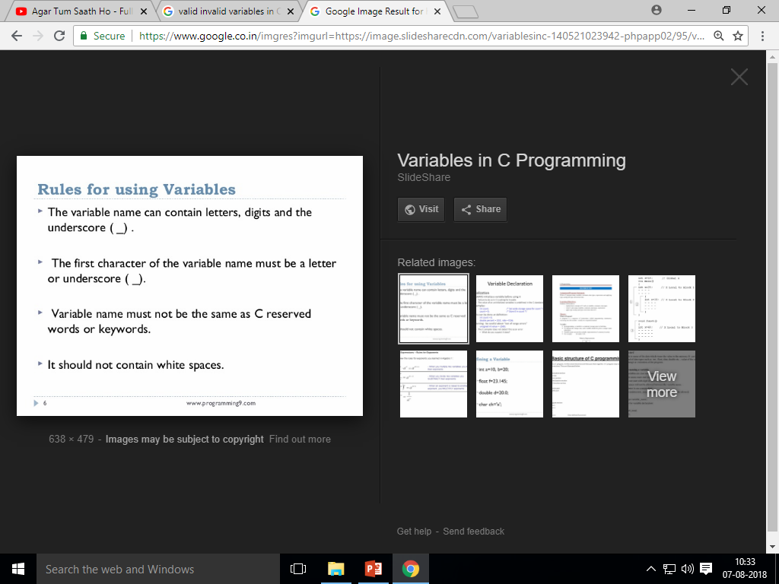
Rules for Variables

Slide 35
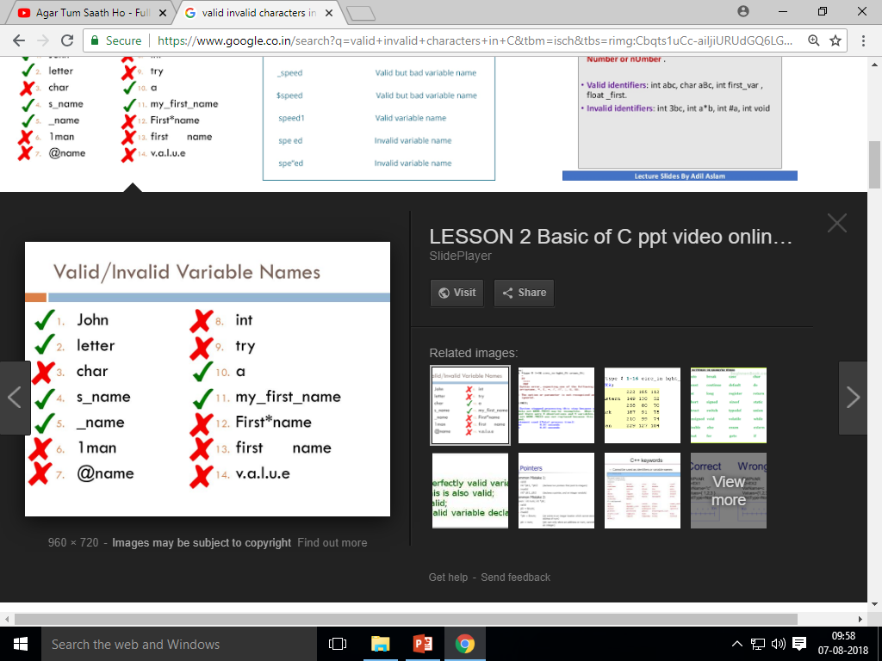

Slide 36
Declaring Variables (Var.)
Each var. to be used must be declared with datatype.
Always declare a variable before using it.
Should be declared closed to the point of use in SC
Ends with semicolon ( ; )
Var. cannot be of type void
int emp_num;
float salary;
char grade;
double balance_amount;
int a,b,c,d;

Slide 37
Initializing Variables (Var.)
Giving values to variables declared is called initializing with initial value.
If you do not initialize any value it takes default values.
Default values are garbage values.
int emp_num;
emp_num=7;
Or
int emp_num=7;

Slide 38
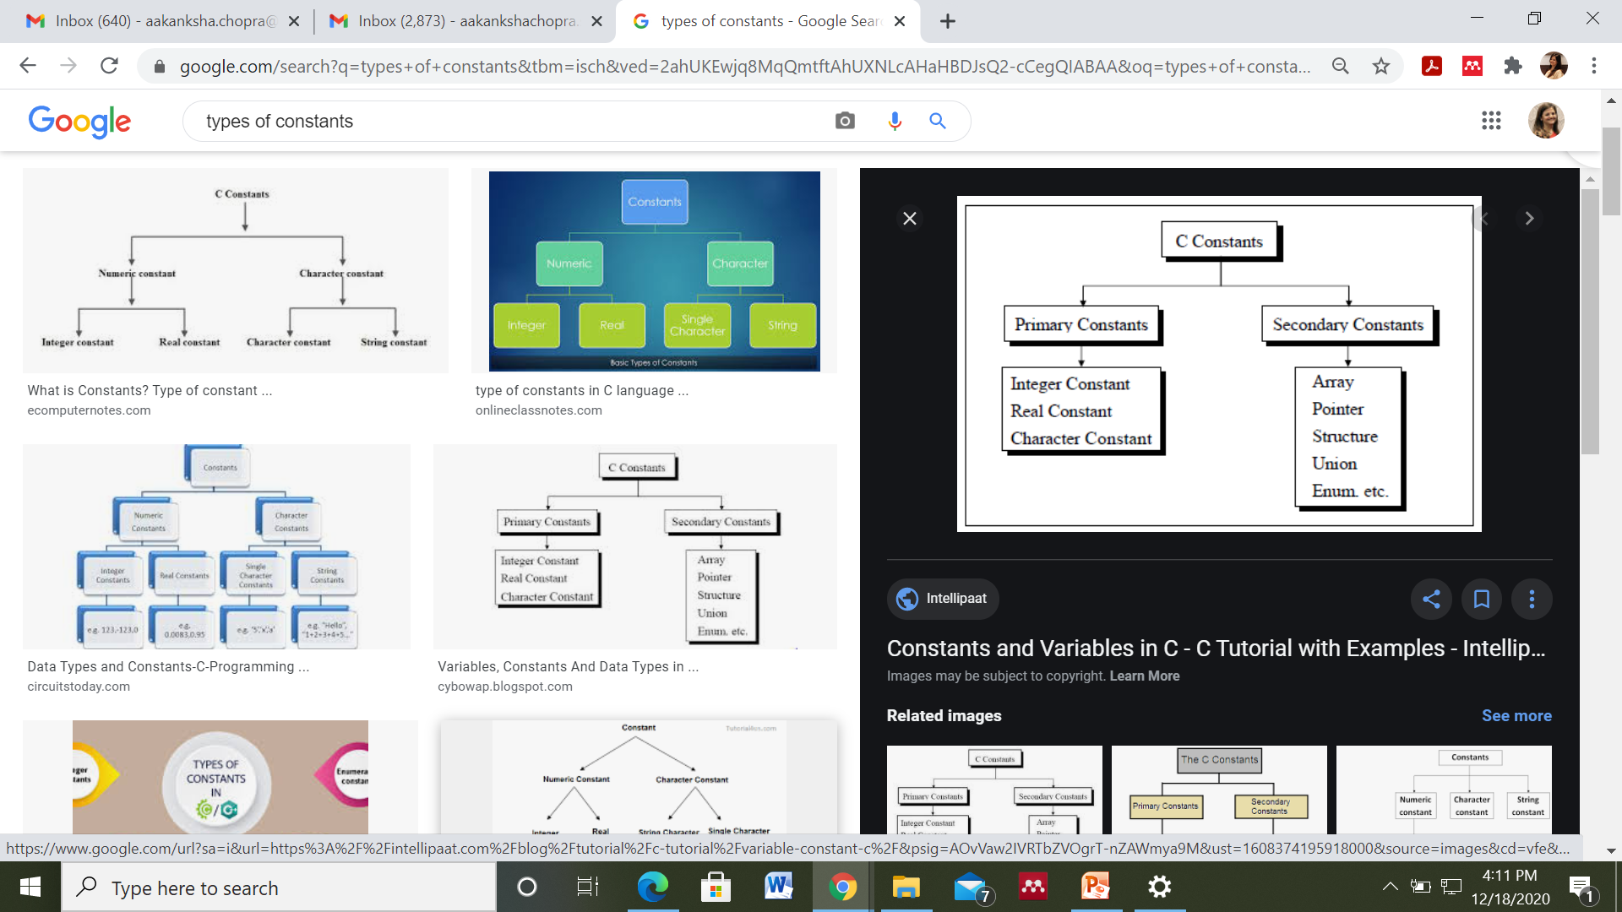
Constants
There value do not change
Fixed values, explicit data values specified by programmers.
Eg- pi
#define pi 3.1459
#define serv_tax 0.12
const float pi=3.14;

Slide 39
Syntax error- compile time error
If syntax error found in code then compiler will not perform its task of converting to object code.
Syntax errors may be spelling, typing mistakes
How we write something.
Remove these errors first to get output
Shows no output
Eg- int a=5 (semicolon missing)
Eg- x_y+z (underscore is not ‘=‘ operator)
Aakanksha Chopra, Asst. Professor(IT)

Slide 40
Semantic Error/Logical Error- run time error
If it occurs program does not works accurately.
Run-time error.
Meaning is wrong
We get output
But we get wrong output
Eg- a=b+c
(instead of a=d+c)
Eg- x%10
(instead of x/10)
Aakanksha Chopra, Asst. Professor(IT)

Slide 41
Block structured language
C is not a block structured language. Because it does not allow defining function within a function or block within a block.
If(x=10)
{
printf(“two low”);
printf(“%d”, &x);
}
// above is block of code.
Aakanksha Chopra, Asst. Professor(IT)

Slide 42
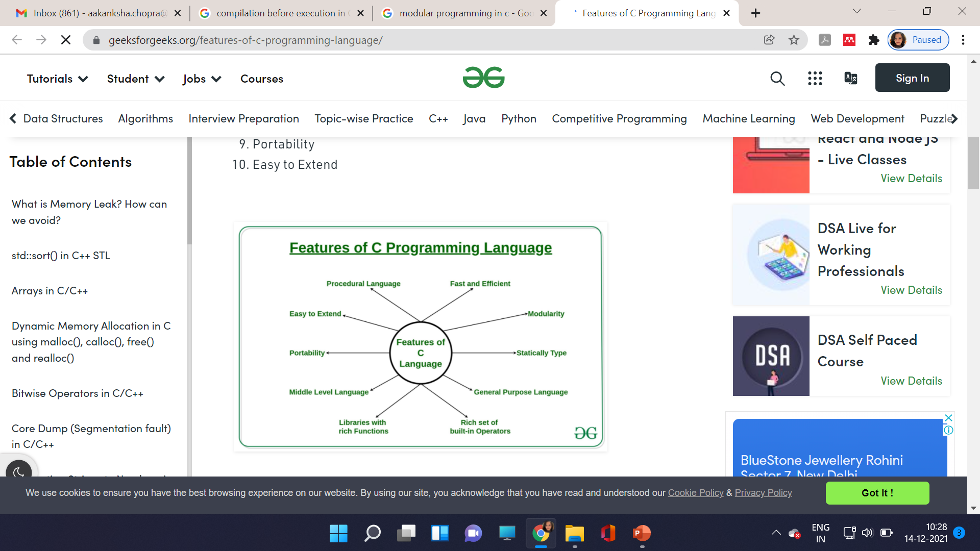

Slide 43
Files in C programming

Slide 44
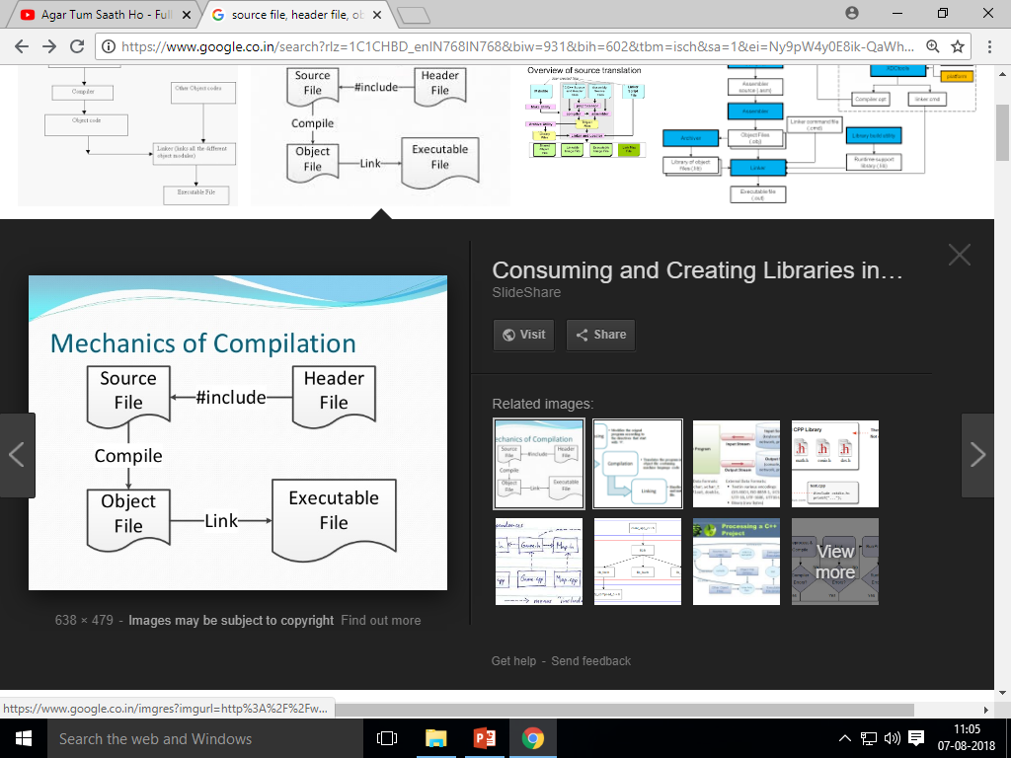
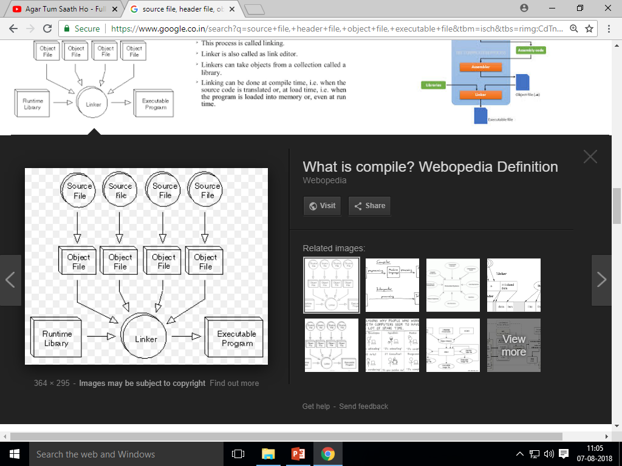

Slide 45
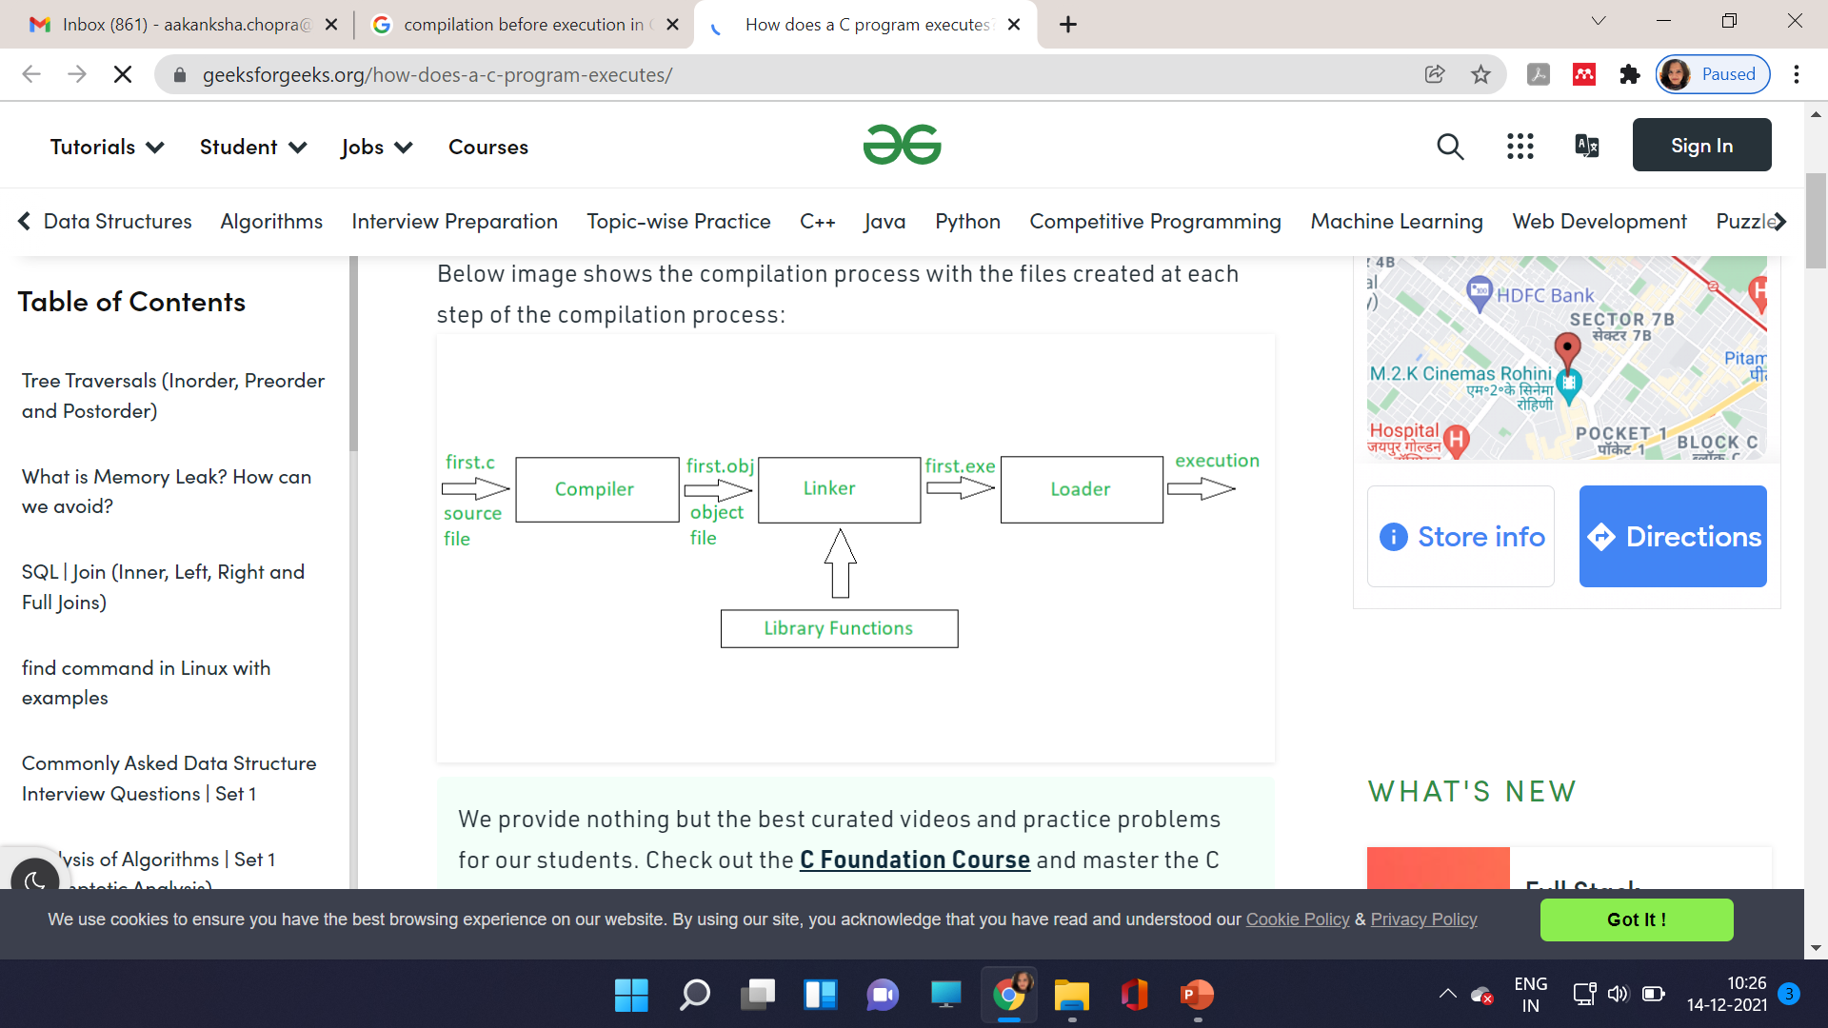
Compilation before Execution

Slide 46
Streams
Vario0us streams for input and output are there.
Acts in 2 ways- source & destination
C program I/P & O/P data from stream
Streams are associated with physical device such as the monitor or a file stored on the secondary memory
keyboard
Input text stream
Data
Monitor
Output text stream
Data

Slide 47
STRUCTURE OF ‘C’ PROGRAM
Preprocessor directives
Global Declarations
main()
{ Local Declaration
Statements
}
Function_1()
{
Local Declaration
Statements
}
.
.
.
.
Function_n()
{
Local Declaration
Statements
}

Slide 48
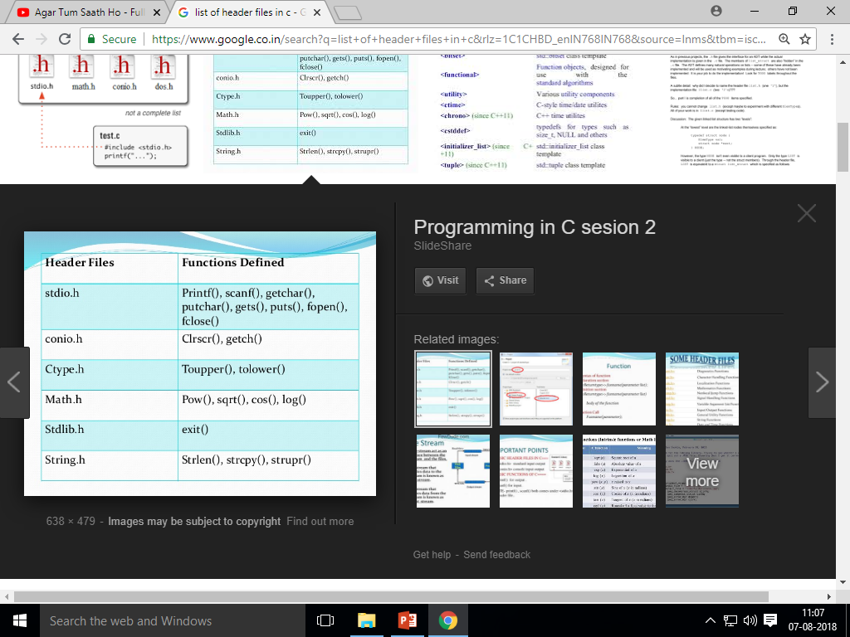
Header Files

Slide 49
Program requirements
Stdio.h
Conio.h
.c file
.h file
.o file
.exe file
Printf()
Scanf()

Slide 50
Input/ Output Statement in C
printf()
scanf()
printf(“<format string>”,list of variables);
printf(“%d %d”,a,b);
scanf(“<control string>”,argument 1, argument 2, argument 3,……….argument N);
scanf(“%d %f %c %d”,&a,&b,&g,&t);

Slide 51
printf()
Is used to convert data stored in the program into a text stream for give output on the monitor.
printf()- stands for PRINT FORMATING.
Used to display information required by the user and also to print values of the variables.

Slide 52
scanf()
Is used to convert text stream coming from the keyboard to fata values & stores them in program variables.
scanf()- stands for SCAN FORMATING.
Used to store formatted data from the keyboard.
‘&’- address of operator
is must before variable name- it stores address of variable.

Slide 53
Access specifiers
Integer- %d
String- %s
Float- %f
Character-%c
Long Double- %L
Short/unsigned integer-%h
Long/unsigned integer-%l

